Slide 1
LibrarySpace. MakerSpace. TechSpace
Jackie Child and Megan Daley

Slide 2
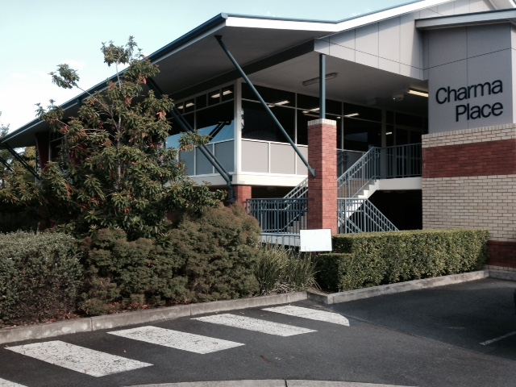
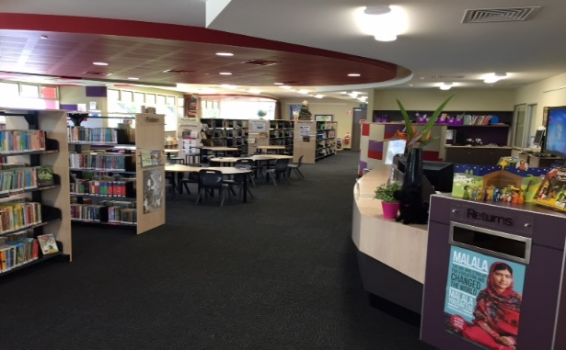
St Aidan’s Anglican Girls’ School is located in Brisbane in the Western suburbs.
Junior School enrolment: 215
Senior School enrolment: 513
Junior Library was built in 2010 as part of the BER funding.
Equivalent of one full time teacher librarian and a .8 library technician. We job share the TL role.
We have a full timetable through the week (between us we also teach Geography, History, English Extension and Sport) with approx. 2 hours of release time between us.
We run our MakerSpace Zone on pure enthusiasm!

Slide 3
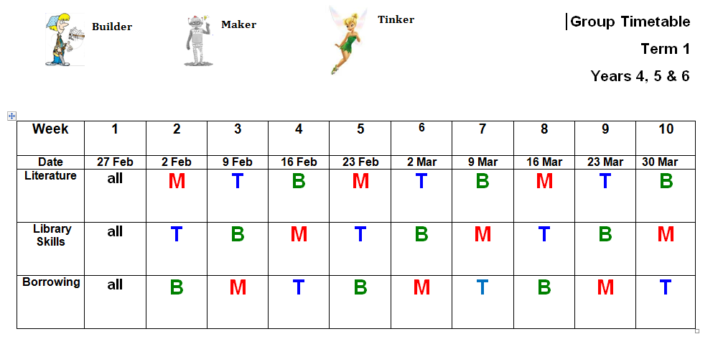
How we structure our week…..
* K-3 Borrow 3 books per week with whole class lessons
* 4-6 Group rotations using a timetable (3 week rotations –literature, library skills, borrowing)
* Lessons 40 mins each week
* Borrowing before school, lunch and after school

Slide 4
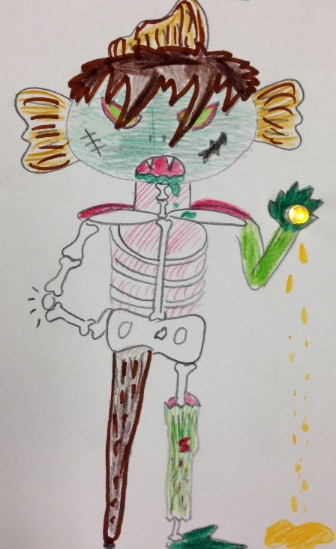
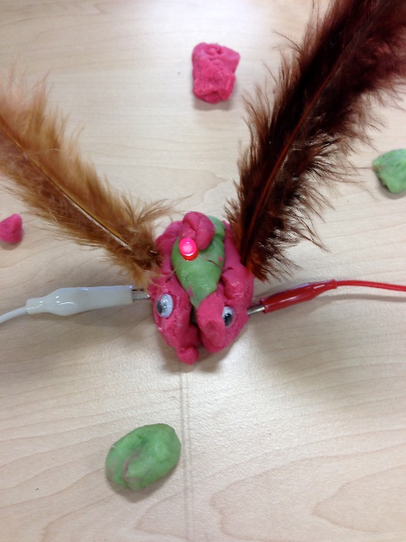
How we started…..
Attended a forum at The Edge, SLQ on Makerspaces
Shared ideas with Principal
Started research http://childrensbooksdaily.com/school-libraries-makerspace-movement/
Guided ‘making’ and ‘tinkering’ with Year 5/6 students as a ‘trial’
inspired from A Very Unusual Pursuit
by Catherine Jinks

Slide 5
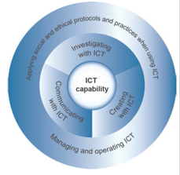
Australian Curriculum
Inquiry based learning underpins much of the Australian Curriculum and thus the role of the teacher librarian has never been more crucial in education in needing to equip students with new skills, knowledge and ways of learning to cope with the demands of today’s information overloaded society.
We needed to ensure that our MakerSpace addressed the curriculum.
* ICT capability supports and enhances student learning across
all areas of the curriculum.
* Subject areas…… such as English and Geography.
* Cross-curriculum Priorities………Sustainability
Principal’s approval to continue.

Slide 6
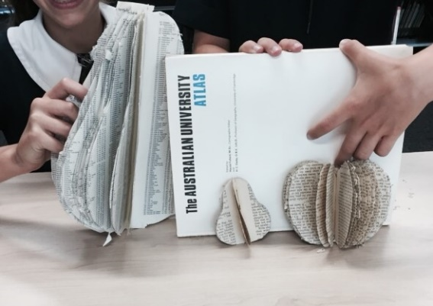
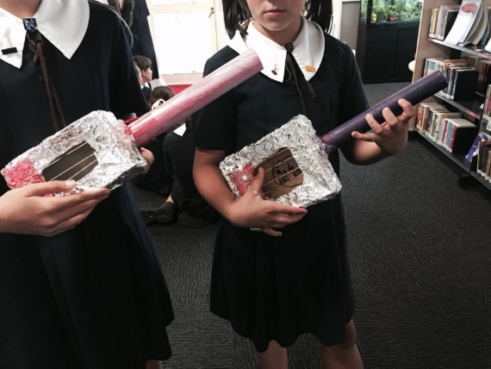
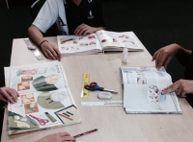
Making to Learn. Books = Ideas
Library Skills – Non fiction
Selecting books from non-fiction
Designing, resourcing and creating
Sharing
Making, Building and Creating to Learn Blog

Slide 7
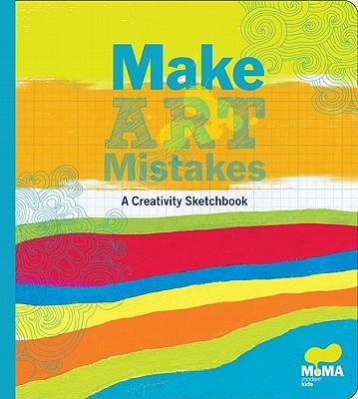
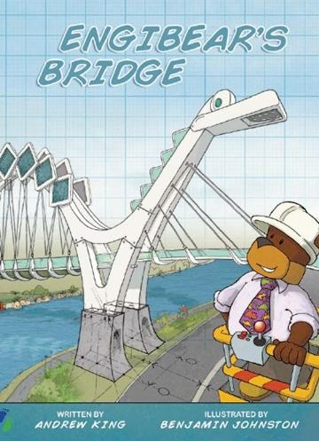
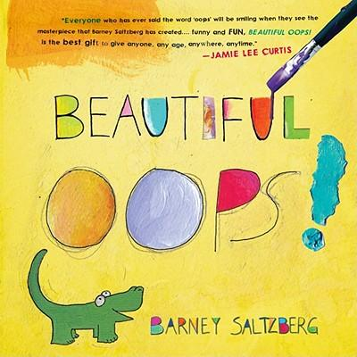
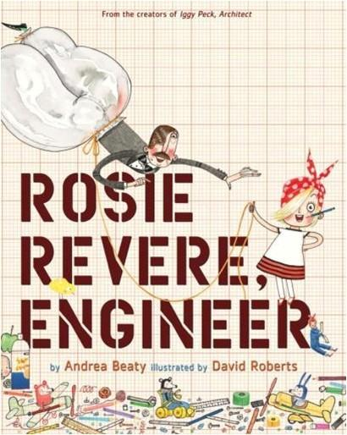
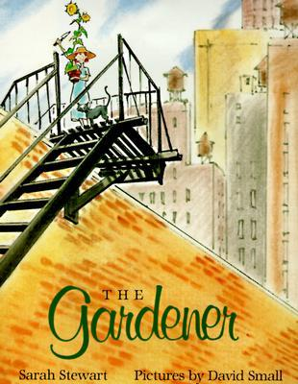
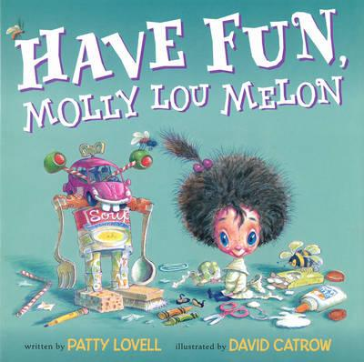
Maker Vocabulary
We have searched high and low for illustrated fiction books which support the idea that it’s important to ‘have a go’ and that failure is as important as success. We armed our students with the vocabulary to talk about making and tinkering and encourage a growth mindset.
You can see the fiction books which support these ideas here: www.childrensbookdaily.com/childrens-books-about-making-failing-trying-succeeding

Slide 8
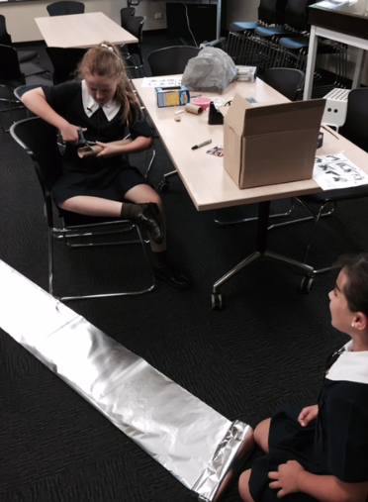
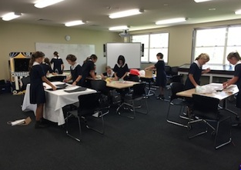
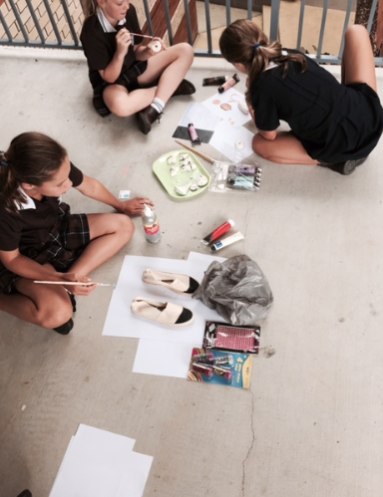
#Making Space

Slide 9
#lowtech #hightech
Not all learning opportunities in a makerspace environment need be high tech. In fact, some of the very best of learning experiences in a makerspace environment are created with cardboard construction https://www.youtube.com/watch?v=faIFNkdq96U
Super Awesome Sylvia is another inspiring young lady to look out for…
http://sylviashow.com/tags/maker-faire http://sylviashow.com/episodes
Pinterest board on Makerspace ideas http://pinterest.com/jackiechild/makerspaces/

Slide 10
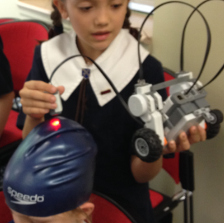
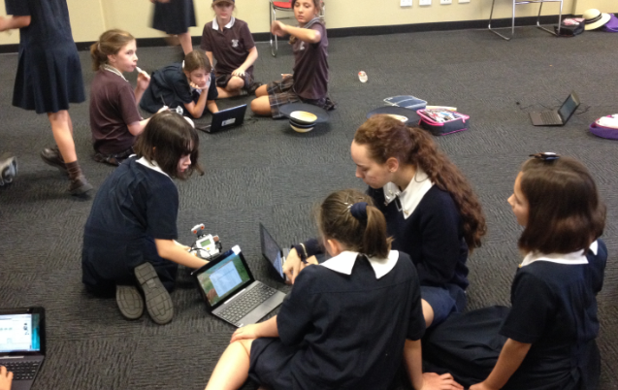
#Code Club
We run a Code Club and Robotics Club in the MakerSpace Zone
Unplugged activities
http://csunplugged.org/
IPad apps & software https://www.commonsensemedia.org/lists/coding-apps-and-websites
http://www.edutopia.org/blog/7-apps-teaching-children-coding-anna-adam

Slide 11
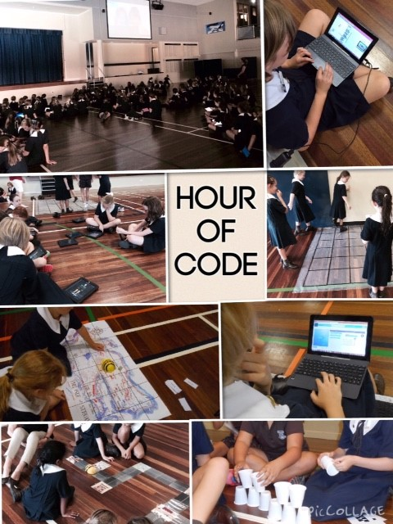
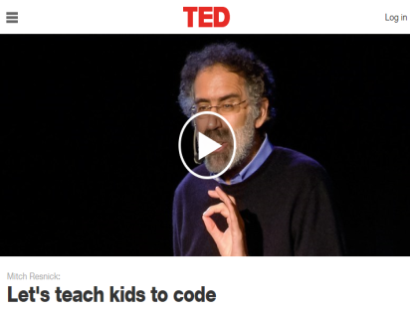
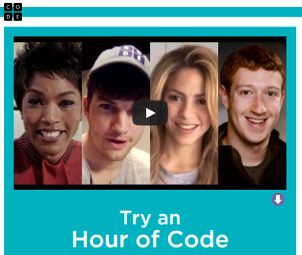
Creativity…….creating and making
Problem solving
Logical thinking
Computational thinking
Algorithms
Structured thinking
Designing
Making mistakes……learning from them, persistence
New literacy…… loop, variables, scale, repeat, branching,
Language of the future
Exploring and playing….best way to learn
Project Based Learning

Slide 12
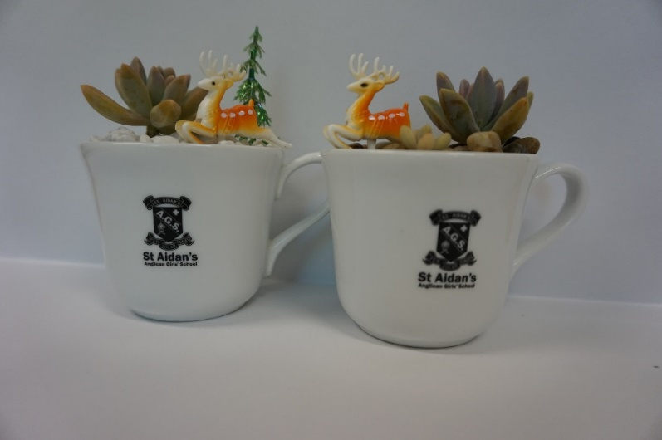
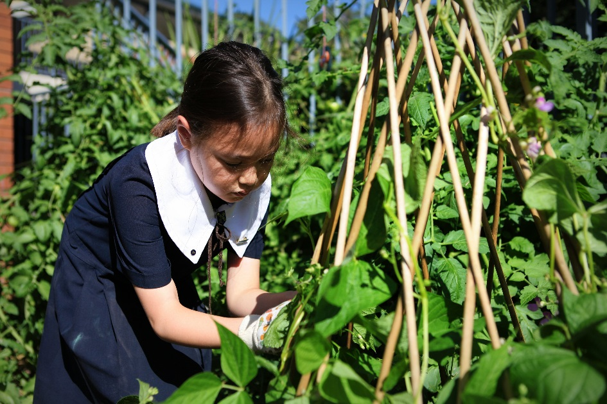
#lowtech: Earth Angels
The Earth Angels are a group of students interested in making our school environment a better place through the development of sustainable practices such as maintaining our school vegetable patch, worm farms and composting systems, undertaking waste audits and managing a re-usable tuckshop bag system to reduce paper bag use. The Earth Angels use library resources (primarily our non-fiction collection) to plan our crop planting calendar, find recipes to use with our crops, work out sustainable crafts and learn more about our worm farms and composting systems.

Slide 13
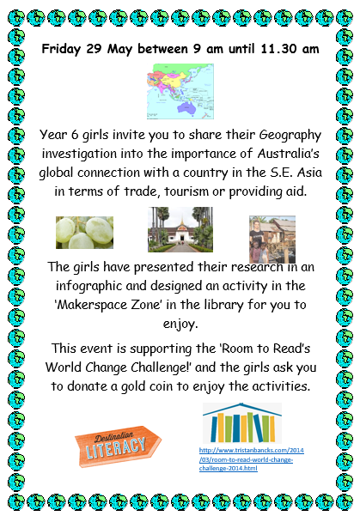
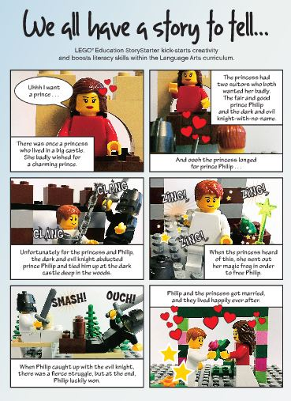
Promoting our #MakerSpace Zone
Getting our school community supporting the area
Library Lessons
Subject lessons
Extension English

Slide 14
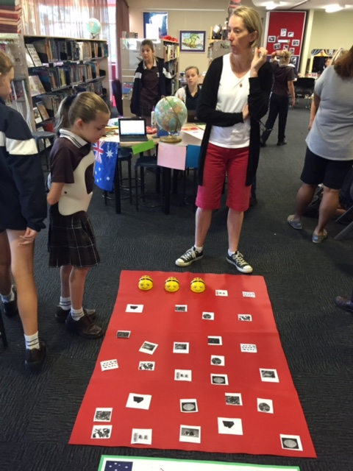
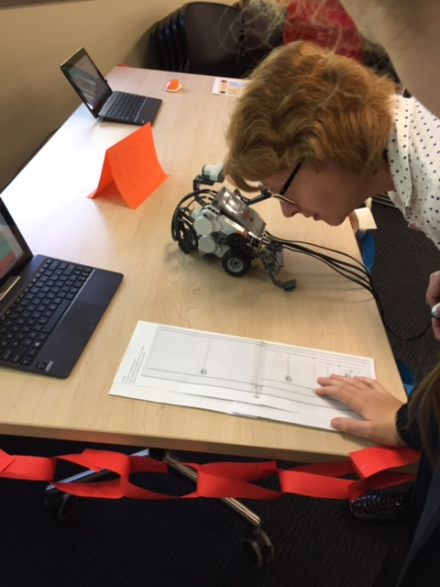
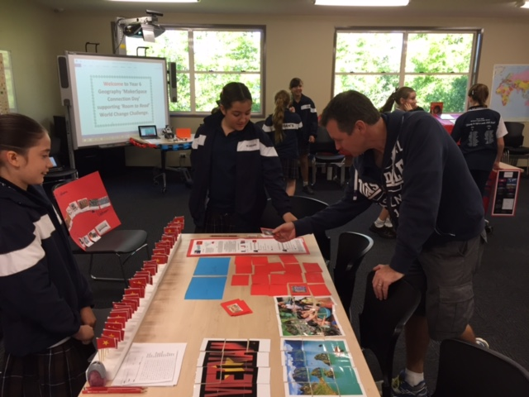
Promoting our #MakerSpace with a Geography ‘Mini Maker Faire’ !
Connected to Geography Curriculum
Information was presented as an Infographic
Makerspace Connection Day ……..Mini Maker Faire
Supported and raised funds for Room to Read World Change Challenge!
Tristan Bancks Skyped

Slide 15
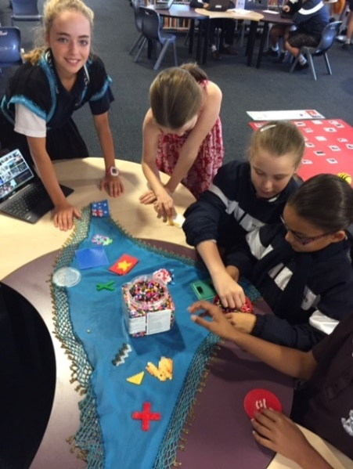
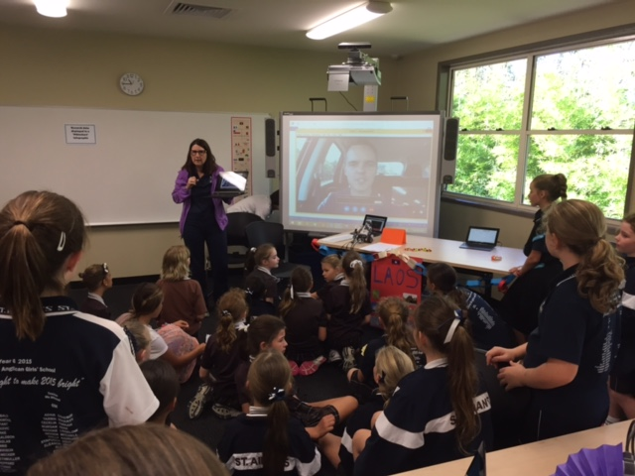
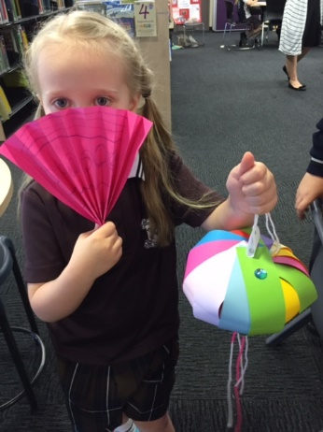
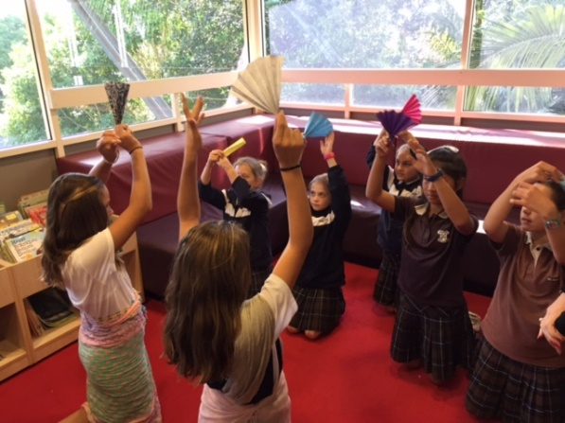
Geography ‘Mini Maker Faire’

Slide 16
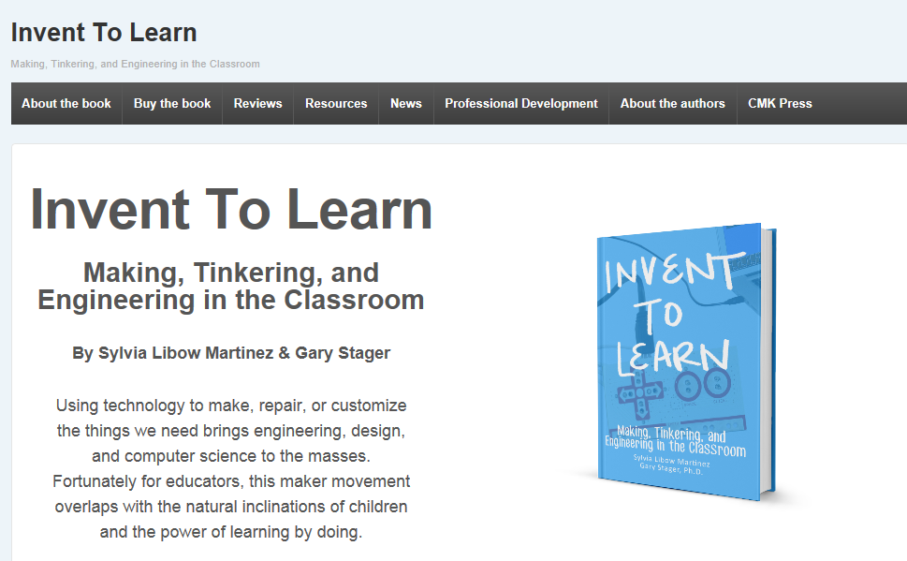
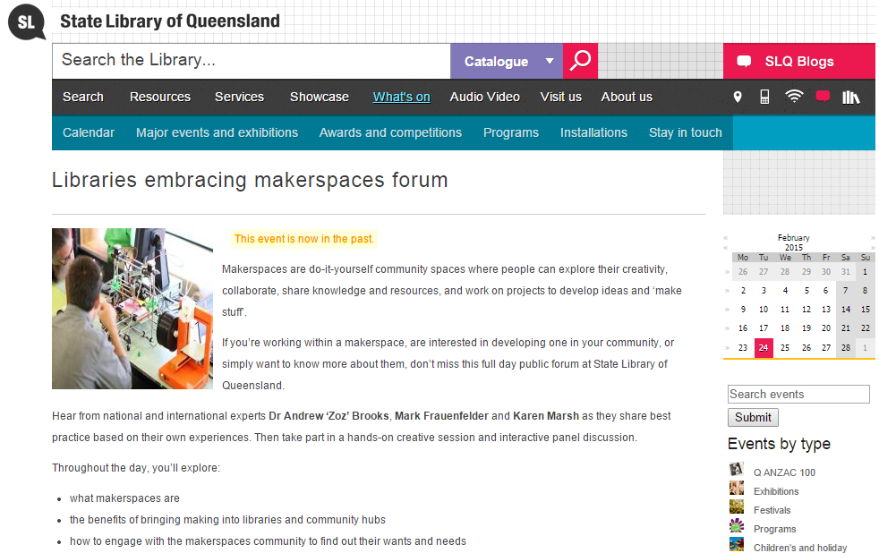
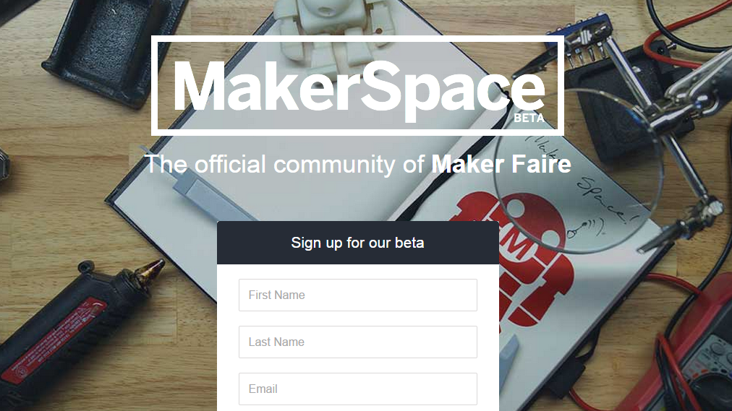
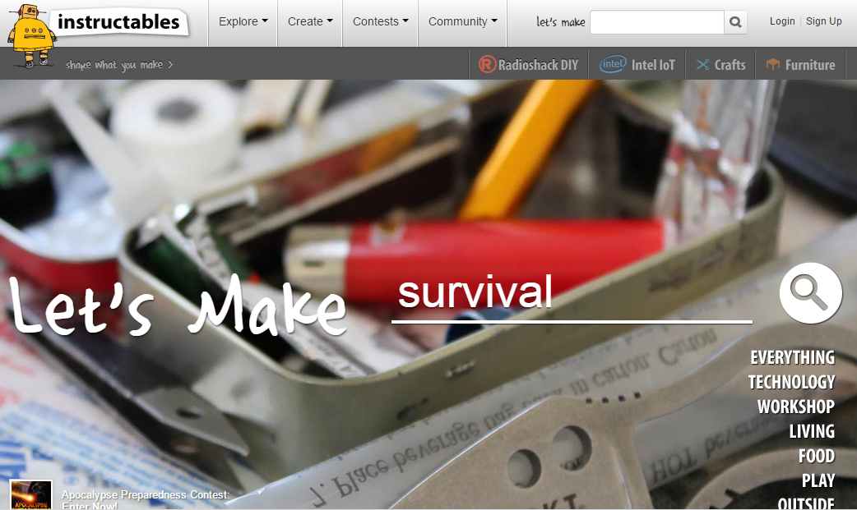
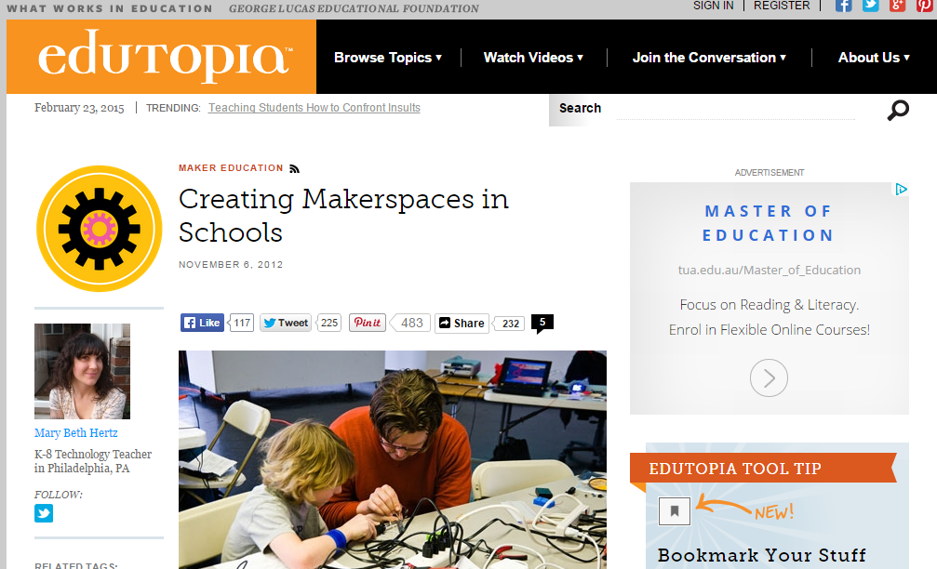
Useful #Makerspace Links
http://www.inventtolearn.com/
http://www.slq.qld.gov.au/whats-on/calevents/general/talks/makerspaces
http://makerspace.com/
https://www.adafruit.com/
http://www.bareconductive.com/
http://www.instructables.com/
http://www.edutopia.org/blog/creating-makerspaces-in-schools-mary-beth-hertz

Slide 17
Where to now…..
Promoting within school
Considering an after school evening of ‘Makers’
Developing more storage space
Purchase more equipment i.e. Little Bits
Continue our own learning……
Thank you and we hope you have found something useful from our session!

